Slide 1
Vanitha Khetan, Steven Wagner Federal Health Architecture

Slide 2
Strengthening the Federal Health IT Landscape for Improved Health Care and Interoperability

Slide 3
Agenda
Overview of FHA
Overview of Current Federal Health IT Priorities
Getting Involved with the Federal Health Information Model (FHIM)
Strengthening the Federal Health IT Landscape to Support Interoperability and Better Health Care

Slide 4

FHA Overview
Established by the Office of Management and Budget as an E-Government Line of Business (LoB) Initiative
Supports federal activities related to the development and adoption of health IT standards and policies
Ensures that federal agencies seamlessly and securely exchange health data with other agencies, government entities, and with other public and private organizations

Slide 5
FHA Overview…Continued
March 2004
The Office of Management and Budget (OMB) initiated a government-wide analysis of five lines of business (LoBs) supporting the President's Management Agenda goal to expand Electronic Government
Goal: identify opportunities to reduce the cost of government and improve services to citizens through business performance improvements
HHS is the managing partner for two Lines of Business
Federal Health Architecture (FHA)
Grants Management Line of Business (U.S. Office of Management and Budget)
Notes:
In March 2004, the Office of Management and Budget (OMB) initiated a government-wide analysis of five lines of business (LoBs) supporting the President's Management Agenda goal to expand Electronic Government.
Interagency taskforces examined business and information technology data and best practices for each line of business – financial, human resources, grants, health, and case management systems. The goal of the effort is to identify opportunities to reduce the cost of government and improve services to citizens through business performance improvements.
HHS is the managing partner for 3 E-Gov Initiatives/Lines of Business: Grants.gov Initiative (Grants.gov)
Federal Health Architecture (FHA)
Grants Management Line of Business (U.S. Office of Management and Budget)

Slide 6
What is FHA?
FHA Moving Forward: 2015
STRATEGIC GOALS
Establish a unified federal voice on health data exchange and interoperability
Establish FHA as a “convener of stature”, and broaden participation
Institutionalize governance decision-making processes
Expand outreach and access to tools
Achieve adoption of interoperability specifications, leading to active data exchange in the Federal health community
Support S&I Framework by providing federal use cases and pilots
Enable FHA partners to move from legacy to new solutions in effective, coordinated manner
Align federal policies in healthcare data exchange
Provide a forum for the cataloging and aligning of federal policies and practices
FHA Guiding Principles
Stakeholder Engagement
Demonstrate through Pilots
Open Communication and Transparency
Commitment to Action
Focus on Specifications

Slide 7

What is FHA?
Currently partnering with more than 20 federal agencies including the Department of Health and Human Services, Department of Defense, Centers for Medicare & Medicaid Services, Department of Veterans’ Affairs, Social Security Administration and Indian Health Services

Slide 8

Federal Partner Focus Areas
Healthcare Directory (HcDir):
Focused on reviewing current directories
Recently developed assessment and evaluation criteria
Currently being reviewed by the FHA Managing Board
Healthcare Provider Directory Pilot
Prototype is focused on complex queries utilizing a RESTful Application Provider Interface (API) demonstrated through a Web-based front end.
FHA is currently looking for federal agencies to participate in the pilot phase
Patient Consent & Authorization
Working with federal partners on revising the purpose and scope of work
Directed Exchange:
Published multiple guidance/recommendation documents on healthit.gov
Facilitating federal partner collaboration/involvement with DirectTrust

Slide 9
Federal Partner Focus Areas…Continued
CONNECT Released CONNECT 4.5 in July
Includes Direct functionality
Can be used on WebLogic and JBoss Wildfly
Deep dive presentation: https://connectopensource.atlassian.net/wiki/display/CONNECTWIKI/Wiki
Federal Interoperability Metrics Initiative: Finalizing charter to support federal partners’ needs in the area of metrics supporting interoperability requirements
Federal Health Information Model
A logical information model designed to enhance semantic interoperability
Architecture:
Current-State Federal Health Architecture
FHA Future State Model
Federal Architect’s Council
Notes:
Current-State Federal Health Architecture: The Current-State Federal Health Architecture will provide an authoritative description of the current federal health environment to support analysis.
FHA Future State Model: This 2025 Target-State Federal Health Information Technology Architecture will harmonize federal partner agency priorities and the national health IT objectives using a data-driven approach.
The Federal Architect’s Council is focused on identifying the structure components that make up the federal healthcare ecosystem, determining their relationships, identifying gaps and overlaps in order to develop effective solutions and improving communications at the policy, business and technical levels of the federal healthcare ecosystem. The council hosted its first meeting on September 16.

Slide 10

CONNECT Project
CONNECT is a software platform that supports secure health information exchange via Direct and SOAP-based exchanges
CONNECT uses ONC Nationwide Health Information Network standards and governance to ensure interoperability with current and future exchanges
CONNECT is a cost-efficient, open source solution that is designed to be flexible -- supporting an evolving health data exchange environment

Slide 11

Federal Health Information Model
A Logical Information Model of Health Data developed in collaboration with the federal agencies
Harmonizes content (information, terminologies and value sets) across federal partners and standards organizations
Integrated with open source Model Driven Health Tools (MDHT)
Can generate HIE Implementation standards for multiple Platform Specific Models (PSMs)

Slide 12
FHIM Information Domains
FHIM Information Domains
Information Domain | Information Modeling Status | Terminology Modeling Status
AdverseEventReporting | Complete | Complete
Allergies | Complete | Complete
Assessment | Complete | To Be Modeled
Audiology And Speech Pathology | To Be Modeled | To Be Modeled
BehavioralHealth | Partially Complete | To Be Modeled
BloodBank | To Be Modeled | To Be Modeled
CarePlan | Complete | In Progress
ClinicalDecisionSupport | To Be Modeled | To Be Modeled
ClinicalDocument | To Be Modeled | To Be Modeled
Consultation | To Be Modeled | To Be Modeled
ClinicalObservation | Complete | To Be Modeled
Dental | To Be Modeled | To Be Modeled
Dietetics | To Be Modeled | To Be Modeled
Encounter | Complete | To Be Modeled
EnrollEligibilityCOB | Complete | To Be Modeled
HealthConcern | Complete | Complete
HomeBasedPrimaryCare | To Be Modeled | To Be Modeled
Imaging | In Progress | To Be Modeled
Immunizations | Complete | Complete
FHIM Information Domains
Information Domain | Information Modeling Status | Terminology Modeling Status
Lab | Complete | Complete
OncologyRegistry | To Be Modeled | To Be Modeled
Orders | Complete | Complete
PatientEducation | To Be Modeled | To Be Modeled
Person | Complete | Complete
Medications/Pharmacy | Complete | Complete
Prosthetics | To Be Modeled | To Be Modeled
Provider | Complete | Complete
Public Health Reporting | Complete | In Progress
Radiology | In Progress | To Be Modeled
SecurityAndPrivacy | Complete | Complete
SocialWork | To Be Modeled | To Be Modeled
SpinalCord | To Be Modeled | To Be Modeled
Surgery | To Be Modeled | To Be Modeled
VitalSigns | Complete | Complete
WomensHealth | To Be Modeled | To Be Modeled
Common | Complete | To Be Modeled
Datatypes | Complete | Complete

Slide 13
Engagement Opportunities in the Standards & Interoperability (S&I) Framework
Support for federal partner priorities such as Healthcare Directory
Direct support of federal partner use cases
Provides semantic and syntactic modeling constructs to support the definition of information
Combined with MDHT*, can be used to generate implementation standards using an MDA* approach
FHIM
S&I
Scope
Pre-Discovery
Requirements
Use Case
Harmonization
Modeling
Reference Implementation, Test & Pilot
*MDHT = Model Driven Health Tools
*MDA = Model Driven Architecture
Publish
Evaluation
Notes:
In working with the S&I Framework, the FHIM has several opportunities to leverage nationwide standards to further enhance semantic interoperability across the federal healthcare space and generate implementation standards for partners and other organizations looking to exchange health information with federal agencies.

Slide 14
FHIM Mapping to FHIR, C-CDA, Etc.
FHA mapped Meaningful Use 2 data requirements
C-CDA 1.1 templates
Data Access Framework FHIR* Profiles
Quality Improvement Core IG* FHIR Profiles
Structured Data Capture FHIR IG profiles to identify gaps, overlaps, and conflicts (harmonization)
The mapping information is automatically imported into FHIM and allows for continued traceability to information requirements and interoperability specification (i.e. CDA and FHIR IGs)
*FHIR = Fast Healthcare Interoperable Resources
*IG = Implementation Guide
Notes:
Value of mapping FHIM data elements to information exchange format specifications:
A unique meaning is assigned to each data element exchanged and some of the semantic ambiguity still remaining in implementation guides (IGs), templates, and profiles used for conformance testing is removed.
A mechanism for creating additional CDA templates and FHIR profiles to meet the needs of federal partners in a way consistent with existing IGs using information exchange requirements already documented in the FHIM is provided.

Slide 15
Deliverables
Completed
Model 20 of 37 FHIM information domains
Terminology modeling of 12 of 18 FHIM domains
Integration of FHIM and associated terminology models with Model Driven Health Tools (MDHT)
Process guides
Prototyping of each individual process, model and tool
Prototyping of HIE Framework
Generation of a draft implementation standard in CDA & NIEM
Mapped to all S&I Framework initiatives
Draft comparative report between two versions of the FHIM
Definition of a UML profile to support enhanced report generation
Notes:
Information modeling of 20 of 37 FHIM information domains (e.g., Person, Lab, Medications, Health Concerns/Problems, Orders, etc.)
Terminology modeling of 12 of 18 FHIM domains
Integration of FHIM and associated terminology models with Model Driven Health Tools (MDHT)
A complete set of process guides for information, terminology and implementation modeling. Process guides are both a deliverable and a benefit
Prototyping of each individual process, model and tool
Prototyping of HIE Framework (fully integrated processes, models and tools that support the Model Driven Architecture approach to generating HIE standards)
Generation of a draft implementation standard for the exchange of immunization information in both a CDA and NIEM format
Mapped FHIM to all S&I Framework initiatives
Definition of a UML profile to support enhanced report generation
Definition and generation of a draft comparative report between two versions of the FHIM

Slide 16
Deliverables...Continued
In Process
Model 17 of 37 FHIM information domains
Terminology modeling of 25 of 37 FHIM domains
Generate drafts of HIE implementation standards to support federal partner interoperability use cases
Populate the UML profile and begin generating reports
Leverage the FHIM as the information model for the NIEM Health Domain
Migrate the fhims.org to a .gov in FY2016
Notes:
Information modeling of remaining 17 of 37 FHIM information
Terminology modeling of remaining 25 of 37 FHIM domains
Generate drafts of HIE implementation standards to support federal partner interoperability use cases.
Populate the UML profile and begin generating reports
Leverage the FHIM as the information model for the NIEM Health Domain

Slide 17
Federal Health Architecture
Reduce federal health IT spending by maximizing efficiencies
Measure federal agencies’ health IT implementation progress
Improve health outcomes for citizens

Slide 18
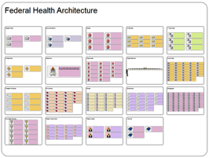
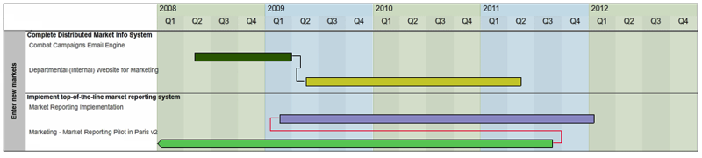
Strategic Architecture Implementation
Structured Database
Data-Driven Dashboard
Notes:
The architecture can be used as an analytical engine to support data-driven decision-making through an easy to interpret dashboard. The example shows how architecture can enable the execution of Strategy Implementation.

Slide 19
Metamodel
Notes:
Here’s a look at how the documents were analyzed. Each column represents the document evaluated. The boxes represent the elements that were extracted from the documents. The text adjacent to the boxes are the fields in the EA Repository (TROUX) that the elements were captured in. The arrows represent the relationships between the elements

Slide 20

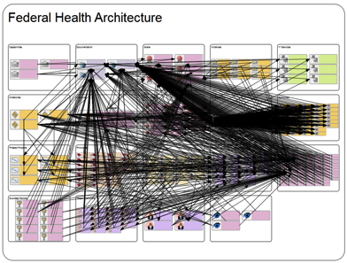
Current Work to get to the Future
Many objects….
…fully integrated
Notes:
Current Questions Addressed by Proof of Concept
What are the dependencies between Federal Health strategies from multiple organizations?
What are the potential gaps and overlaps across the strategies?
What are the impacts to current time frames and strategies based on changes to achievements in milestones?
What strategies are supported by the Pilot Projects?
Potential Questions Strategic Architecture Could Address:
What are the key milestone dates that are impacted by other activities? (would require information regarding milestones and activities from each Federal Partner)
What percentage are we to being able to completing the achievement of a Critical Action, or Learning Health System Requirement (would require detailed milestones and statuses from all of the related partner actions tied to each critical action)
How do all of the partner activities relate back to each of the Objectives from the Federal Health IT Strategic Plan
What laws, regulations, and policies affect each of the Roadmap Critical Actions, Learning Health System Requirements, or FHIT Strat Plan Objectives? (requires information and linkages to laws, regulations, and policies)
What potentially duplicative healthcare functions exist across Federal Agencies (requires information regarding business functions and capabilities from across several Federal Agencies).
What does the IT spend across the Federal Government to address each Interoperability Roadmap Critical Action look like? (would require budget and investment information linked to all of the activities that support each Roadmap Critical Action)

Slide 21
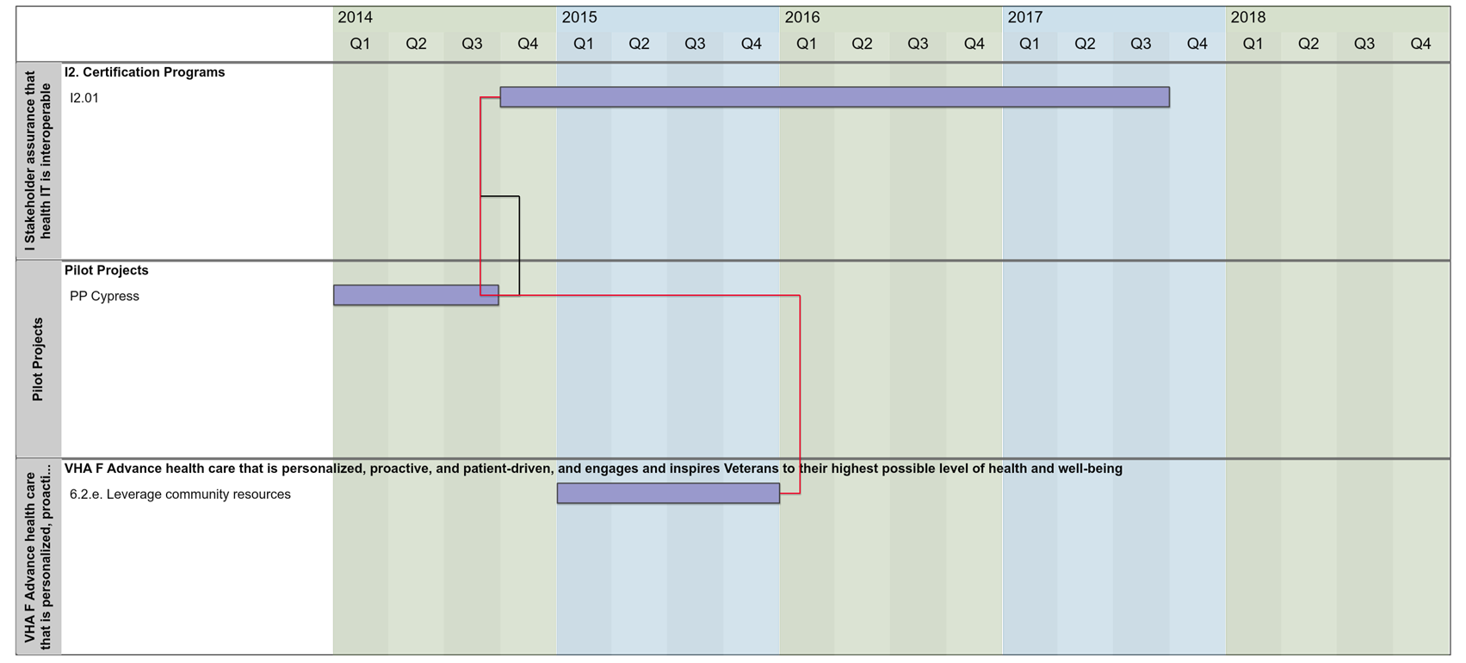
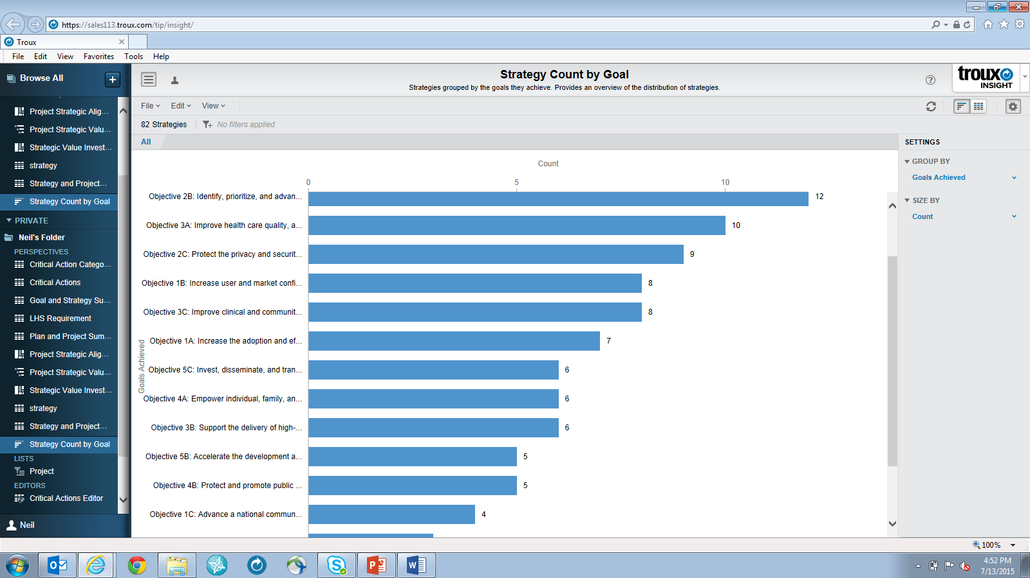
Strategic Planning Threads & Analysis
Notes:
This architecture view shows an integrated thread from the Interoperability Roadmap through its building blocks and Learning Health System Requirements as they VHA Blueprint and existing pilot projects
The VHA transformational action 6.2.e. impacts the start of the ONC critical action I2.01 (the VHA transformation action begins after I2.01). The Linkage is depicted as a broken dependency (red line). However, the time frame associated with the VHA transformational actions are for demonstration purposes only (the VHA Blueprint document did not associate with any timeframes).

Slide 22
Sources being Used and Considered
Currently in Use
Health IT Enabled Quality: A Vision to Achieve Better Health and Health Care (HHS)
Federal Health IT Strategic Plan (HHS)
Connecting Health and Care for the Nation: A Shared Nationwide Interoperability Roadmap Draft Version 1.0 (HHS)
VHA Blueprint for Excellence (VA)
DoD/VA Joint Interoperability Plan (DOD & VA)
10 Year Vision to Achieve Interoperability Health IT Infrastructure (HHS)
In Consideration for Use
AHRQ National Quality Strategy (HHS)
Jason Task Forces Recommendations (HHS)
Jason Report (HHS)
Learning Health System Designs
VistA Evolution Plan (VA)
DHMSM, DMIX Plans (DoD)
TATRC Strategic Plan (DoD)

Slide 23
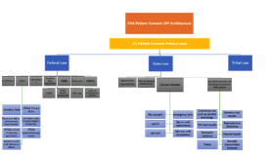
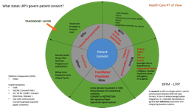
Federal Health Landscape
BRM RA
LRP RA
ORG Matrix
LRP PCA
Notes:
The FHA BRM Framework –
The intent of the framework is to serve as the foundation for business process reengineering (BPR), which drives business improvement by optimizing Operational Activities (OAs), and encouraging interoperability, ensuring Federal Health business systems support and enabling cross functional Business Mission Area processes. Further, the framework provides the basis for assessing audit readiness, financial compliance and earned value benefit realization.
Next Steps - In support of portfolio management, the Business Capability Lifecycle (BCL)4 is an end-to-end process that aligns the requirements, investment, and acquisition processes for the business capability under a single governance framework.
Understanding our FHA BRM Efforts –
identifying the OAs (OV-5) that relate to their Federal Health business functional area and applicable framework at Level 0 business process, and Level 1 major process area. The FHA is responsible for coordinating with the Federal Partners to ensure within the BEA the proper decomposition of Level 1 major process areas, as well as Level 2 process area segment OAs for each Level 1 major process area. For example:
– Information exchanges standardized for interoperability and compliance
– Laws, Regulations and Policies to guide and constrain via implementable business rules
– Constraints within the environment
– SMP Goals and PSA Initiatives
– Enterprise, Strategic, Operational and Tactical performance measures
The other Federal Partners analyze the OAs for a given process to ensure they support interoperability and cross functional integration between Federal Health Business Mission Area functions.
FHA LRP’s
The FHA approach to the management of Federal health information technology (IT) and information-related activities is rooted in Federal laws and regulations that have evolved over the last three decades.
Together these requirements were intended to provide for a coordinated approach to managing Federal agencies‘ information resources.
Other key laws and regulations, external and internal to OMB Federal Health, continue to guide the Department of Defense Information Enterprise in this fast-paced, Information Age global environment. For example, with PCA 42 CFR Part 2 includes the Federal Information Security Management Act, OMB Circular A-130, the National and Defense Information Sharing Strategies, and DoD Information Assurance issuances. All serve as references as we design, build, operate and protect information solutions to gain and maintain the information advantage for DoD personnel and mission partners.
(1) minimize the paperwork burden
(2) ensure the greatest possible public benefit from and maximize the utility of information created, collected, maintained, used, shared and disseminated by or for the Federal Partners.
(3) coordinate, integrate, and to the extent practicable and appropriate, make uniform Federal information resources management policies and practices as a means to improve the productivity, efficiency, and effectiveness of Government programs, including the reduction of information collection burdens on the public and the improvement of service delivery to the public;
(4) improve the quality and use of Federal information to strengthen decision-making, accountability, and openness in Government and society;
(5) minimize the cost to the Federal Government of the creation, collection, maintenance, use, dissemination, and disposition of information;
(6) strengthen the partnership between the Federal Government and State, local, and tribal governments by minimizing the burden and maximizing the utility of information created, collected, maintained, used, disseminated, and retained by or for the Federal Government;
(7) provide for the dissemination of public information on a timely basis, on equitable terms, and in a manner that promotes the utility of the information to the public and makes effective use of information technology;
(8) ensure that the creation, collection, maintenance, use, dissemination, and disposition of information by or for the Federal Government is consistent with applicable laws, including laws relating to
(A) privacy and confidentiality,
(B) security of information
(C) access to information
(9) ensure the integrity, quality, and utility of the Federal statistical system;
(10) ensure that information technology is acquired, used, and managed to improve performance of agency missions, including the reduction of information collection burdens on the public; and
(11) improve the responsibility and accountability of the Office of Management and Budget and all other Federal agencies to Congress and to the public for implementing the information collection review process, information resources management, and related policies and guidelines established under this subchapter.
ORG Relationships Model
This work illustrates the organizational structure and relationships (as opposed to relationships with respect to a business process flow) among organizations, or organization types that are the key players in the business represented by the BRM architecture and the working groups / initiatives that they support.

Slide 24
Federal Health BRM (Early Stage Discussion)
Mission Sectors
(LOB)
Health and Well-Being
(Mission Sector)
Access to Care / Manage Access to Healthcare
Manage Health Benefits Enrollment and Eligibility
Provide Patient Administration
Administer Patient Movement
Communicate Health Services to Eligible Population
Health Care Administration / Manage Access to Healthcare
Determine Operational Status
Develop Operational Concept
Plan Medical Mission
Execute Operations
Manage Health Service Performance
Manage Healthcare Resource
Provide Healthcare Process Improvement
Perform Hospital Administration
Perform Medical Financial Management
Perform Planning and Budgeting
Health Care Delivery Services / Deliver Healthcare
Provide Medical Services
Provide Nursing
Provide Ancillary Services
Provide Geriatrics and Extended Care
Manage Remote Care Services
Provide Clinical Decision Support
Hospital and medical care for American Indians, Alaska Natives
Population Health Management / Provide Population Health Protection
Identify Health Hazard
Define the Target Population
Assign Health Risk
Manage Target Population Health
Mitigate Health Risk
Healthcare Needs of Special Populations
Access to Safe and Efficacious medical products
Health Care Research and Training / Conduct Healthcare Research
Manage Healthcare Research and Development Activities
Conduct Research Project
Report Research Results
Administer Cooperative Studies
Healthcare and Regulatory Science Research
Biomedical Research
Worker Safety
Food and Drug Quality and Safety
Health Insurance
Retirement and Disability Benefits
Unemployment Compensation
Food and Nutrition Assistance
Survivor Compensation
Social Security Benefits
Social Security Beneficiary & Earnings Records
Veteran Benefits and Services
Vocational Rehabilitation
Social Security Identification Management
Business Functions
(Capabilities)
HEALTH
WELL-BEING
Services
(Operational Activities OV-5a)
Where do you fit?
Notes:
The FHA BRM is a hierarchical taxonomy of health functions. At the top most level, it is separated into health and well-being, to align to the FEA BRM. The Health BRM helps to standardize the language used to describe health functions across Federal agencies.

Slide 25
Laws Regulations Policies for Patient Consent & Authorization
Federal Health LRP
IT security
E-Government Act of 2002
Federal Information Security Management Act of 2002 FISMA)
Health Insurance Portability and Accountability Act (HIPAA)
Homeland Security Presidential Directive-12 (HSPD-12)
Homeland Security Presidential Directive-7 (HSPD-7)
OMB Circular A-11
OMB Circular A-130: Management of Federal Information Resources
Privacy
Federal Law
42 CFR Part2 Consent Requirements for Disclosure
42 U.S.C The Public Health and Welfare
HIPAA
Omnibus Rule
HIPAA Privacy Rule
Electronic HIE in a Networked Environment
Openness and Transparency Principle
HIPAA notice of privacy practices
HIPAA psychotherapy notes
Mental Health and Substance Abuse
Jurisdictional Authority
Title 38 Part 1
45 CFR 164. Security and Privacy
Common Rule Regulations
GINA
5 U.S.C. § 552a
FISMA
Public Health Service Act
Self – pay
System Of Record Notices (SORNs)
State Law
Organizational
Laws and Policy
State-designated entities (SDEs)
Consent Models
No consent
emergency only
opt-in
Opt-in with restrictions
opt-out
Opt-out with exceptions
Special treatment and handling of Sensitive Information
Substance use such as alcohol and drugs
Genetics test results
Domestic violence
Mental health
HIV test results
Reproductive Medicine
Sexually transmitted diseases
Teens
Tribal Law
Privacy Act (1974)
Health Insurance Portability and Accountability Act (1996)
Privacy Rule
Patient Self-Determination Act
False Claims Act
Emergency Medical Treatment and Active Labor Act (EMTALA)
Balanced Budget Act (1997)
Federal Medical Care Recovery Act (FMCRA)
Administrative Simplification Compliance Act
Indian Health Care Improvement Act Reauthorization (2001)
Declaration of Health Objectives
Access to Medical Treatment Act (2001)
Requirements
Medically Underserved Access to Care Act (2001)
Drug Availability and Health Care Access Improvement Act (2001)
Health Care Antitrust Improvements Acts (2002)
Alcohol abuse
Alcoholism
Drug abuse
Grant rograms-health
Health records
Privacy Reporting and record keeping requirements
Veterans Omnibus Health Care Act of 1976 (38 U.S.C. §§ 7331 through 7334)
Benefits and Services Act of 1988 (38 U.S.C. § 7332);
Veterans Health Care Expansion Act of 1973 (38 U.S.C. §§ 1751-1754).
Notification In The Case Of Breach Of Unsecured Protected Health Information
Security Standards For The Protection Of Electronic Protected Health Information
Privacy Of Individually Identifiable Health Information
Privacy Act
FERPA
TITLE II
Access to an individual’s health information
Notes:
The working groups that support the BRM’s derives its compliance constraint requirements from the LRP that govern the business functional areas covered in the BRM. The FHA LRP Baseline is delivered with the BRM to provide users with a current set of compliance constraints and their linkages to the working groups that support the BRM.

Slide 26
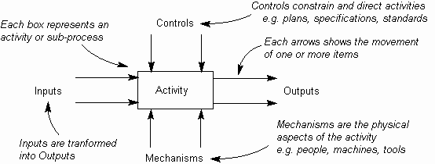
FHA Approach (Process-driven Healthcare)
Health and Well-Being
Access to Care / Manage Access to Healthcare
Health Care Administration / Manage Access to Healthcare
Health Care Delivery Services / Deliver Healthcare
Population Health Management / Provide Population Health Protection
Healthcare Needs of Special Populations
Access to Safe and Efficacious medical products
Health Care Research and Training / Conduct Healthcare Research
Healthcare and Regulatory Science Research
Biomedical Research
Worker Safety
Food and Drug Quality and Safety
Health Insurance
Retirement & Disability Benefits
Unemployment Compensation
Food and Nutrition Assistance
Survivor Compensation
Social Security Benefits
Social Security Beneficiary & Earnings Records
Veteran Benefits & Services
Vocational Rehabilitation
Social Security Identification Management
Mission Sectors
(LOB)
Health
Well-Being
Business Functions
(Capabilities)
Enables / Supports
Working Group Initiatives
Aligns
Charter
Goals
Objectives
Outputs
PCA Working Group
Business Process (PCA)
Segment LRP
Notes:
By defining the relationship between strategy, performance and business functions for a specific organization, the business architecture can show the relative performance of functions and whether or not each organization’s function supports a strategic objective.
Business Architecture is not optional for Business Outcome Driven EA
The value of EA is realized when it is used to deliver business and IT leaders with signature ready recommendations that help to guide the business, people, processes, information and technology investment decisions.
For FHA to strategically view and evolve their businesses overall, including integrating business and IT, to deliver business outcomes, EA must include an understanding of the business, information solutions and technology.
FHA hopes to support a business architecture approach as an integral part of the FHA EA to have a significantly higher ability to execute on our
business strategy because we have a clear understanding of the strategy and its impact on business and IT and the guidance to drive delivery
Without business architecture EA efforts are just IT architecture and will fail to demonstrate and deliver significant business value outcomes.
This is my strategy – show business arch can add value to both the strategy and future planning of Federal Health
Focus on strategically moving the business forward as opposed to holding open ended discussions etc.
Deliverable – form of Business Process – LRP becomes an overlay and separate but tangential work stream
Its mu contention that without business arch we are left with the only a view into information, tech, and solutions. I want to do the opposite and put FHA into a situation that enables and encourages the development of and integrated enterprise (Business and IT) future state vision and execution plans and roadmaps.

Slide 27
Overview of Laws (Consent to Release Information)
38 U.S.C. 7332(b)(2) implemented in 38 CFR 38 CFR § 1.475
Release Patient Information
45 CFR § 164.506(c)
VHA Sharing
HIPAA Sharing
CONSENT
Hinders VHA’s participation in health information technology (IT) interoperability initiatives
without CONSENT
Non- VHA provider needs medical info related to VHA patients condition
Both public and private providers can share any information for treatment purposes with out authorization
Consent / Valid authorization
Conflict
Provider must supply consent before information is shared
Enables
Hinders
Interoperability
Executive Order 13335

Slide 28





More about Federal Health IT Initiatives
ONC website: www.healthit.gov
Direct Project website: www.directproject.org
S&I Framework wiki: http://wiki.siframework.org
CONNECT website: wiki.connectopensource.org
Federal Health Information Model http://www.fhims.org/

Slide 29


Stay Connected, Communicate and Collaborate
Find out more about FHA on the ONC website: http://www.healthit.gov/FHA
Schedule a meeting with FHA or send your thoughts at: federal.health@hhs.gov
@ONC_FHA,
@CONNECT_Project
Federal Health Architecture http://www.flickr.com/photosfederalhealtharchitecture/
SUBSCRIBE, WATCH, AND SHARE:

Slide 30

Stay Connected, Communicate and Collaborate
Subscribe to:
FHA Weekly Bulletin A weekly round-up of FHA and appropriate ONC meetings, and relevant industry events
The Pulse A bi-monthly e-newsletter featuring news about FHA and FHA partner activities, and ONC programs

